Slide 1
Section 4.3
Applications and Solving Problems Using The Pythagorean Theorem

Slide 2
Solving Problems Using the Pythagorean Thm:
Most problems that involves a right triangle of some sort requires the use of the Pythagorean thm.
In some of the problems of this lesson, you will need to “find” or create a right triangle to find a missing side or length
The easy questions may require just the use of the Pyth. Thm or the use of a Pythagorean Triple
Harder questions would require some algebra, like the example below:
Solve for “x” in the right triangle:
The lengths of the side will be:

Slide 3
A 32m tall tree is broken during a severe storm. The distance from the base of the tree to the tip where it touches the ground is 16m. At what height did the tree break?
The tree broke at a
height of 12m

Slide 4
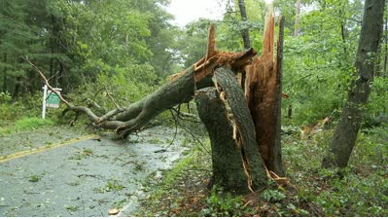

Slide 5

Ex: Two boats are sailing away from the same port. The 1st boat sails West at 15km/hr, the 2nd boat sails North at 22km/hr. How far are the boats from each other after 2.5hours?
First find the distance that each will
boat travel
Boat A:
Boat B:
The distance creates a right triangle
0 0 0
0 0 0
X 0 0
Use the Pythagorean theorem to find
the length of the hypotenuse
X 0 0
Port
© Copyright all rights reserved to Homework depot: www.BCMath.ca

Slide 6
Ex: Two buildings are 95meters apart. Building A is 55m tall and the tower is 145m tall. A wire is connecting both buildings. What is the shortest length for this wire?
Create a right triangle
Find the length of each side
Use the Pythagorean
theorem to find the
length of the wire
© Copyright all rights reserved to Homework depot: www.BCMath.ca

Slide 7
Right Triangle THm:
Suppose you have many triangles arranged like the image below with each side length given:

Slide 8
Ex: Jack and James are racing from point A to B. Jack runs around the park and James cuts through the park. How much more distance did Jack run?
Jack runs on the sides:
James runs along the hypotenuse
Subtract to see how much more
Jack runs
© Copyright all rights reserved to Homework depot: www.BCMath.ca

Slide 9
Right Triangles with Circle Geometry:
Here are some circle geometry properties that involves right triangles and could be useful for solving problems:
Property 1: All angles in a circle inscribed by the diameter is equal to 90 degrees:
If this green line is a diameter, then any angle created will be 90 degrees!
Property 2: Any line tangent to a circle is perpendicular to the radius at the point where it touches
A line tangent to a circle touches it at only ONE point!!
The radius and the tangent line will intersect at 90 degrees
Property 3: If a radius bisects a chord, it will be perpendicular to it
A chord is any line inside a circle where both ends are on the circumference

Slide 10
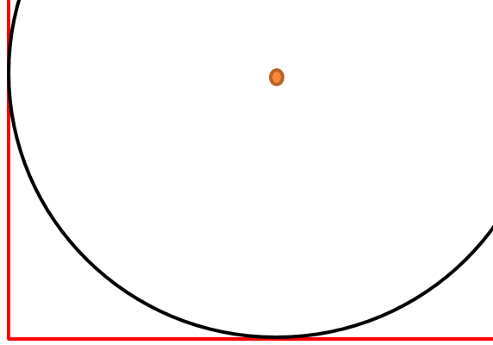
Ex: A circle is tangent to the two sides of a rectangle as shown. What is the radius of the circle?

Slide 11
Ex: find the radius of both circles:

Slide 12
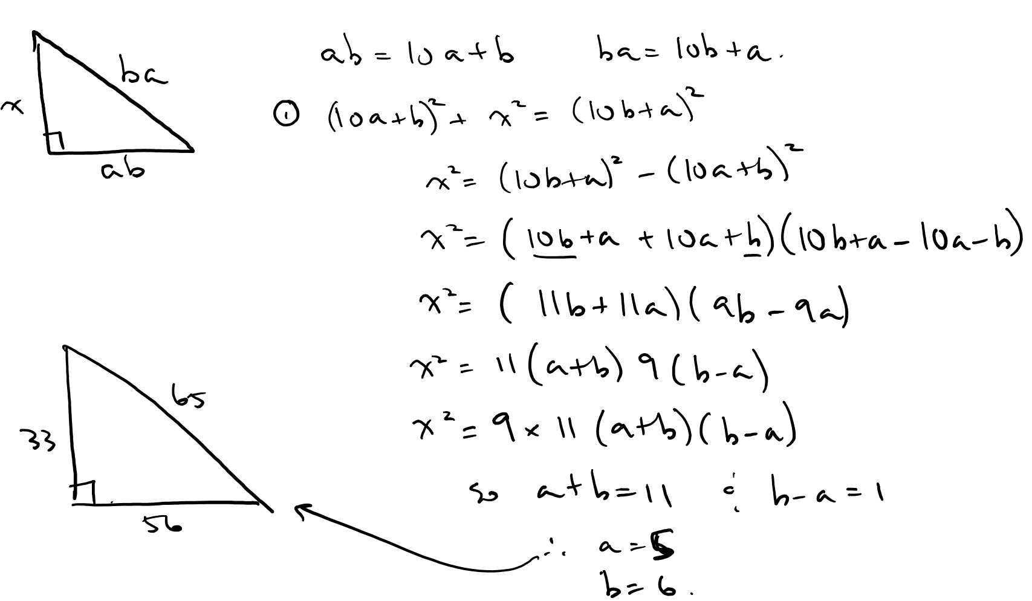
Ex: The three sides of a right triangle are different two digit whole numbers. If the hypotenuse is the reverse digits of one of the sides, find the smallest possible triangle.
Answer:

Slide 13
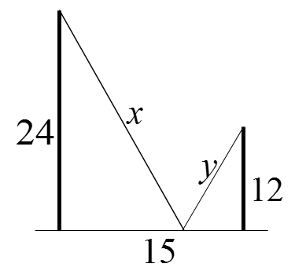
Q: What is the shortest length of “x+y”

Slide 14
Q: What is the shortest length of “x+y”

